Slide 1

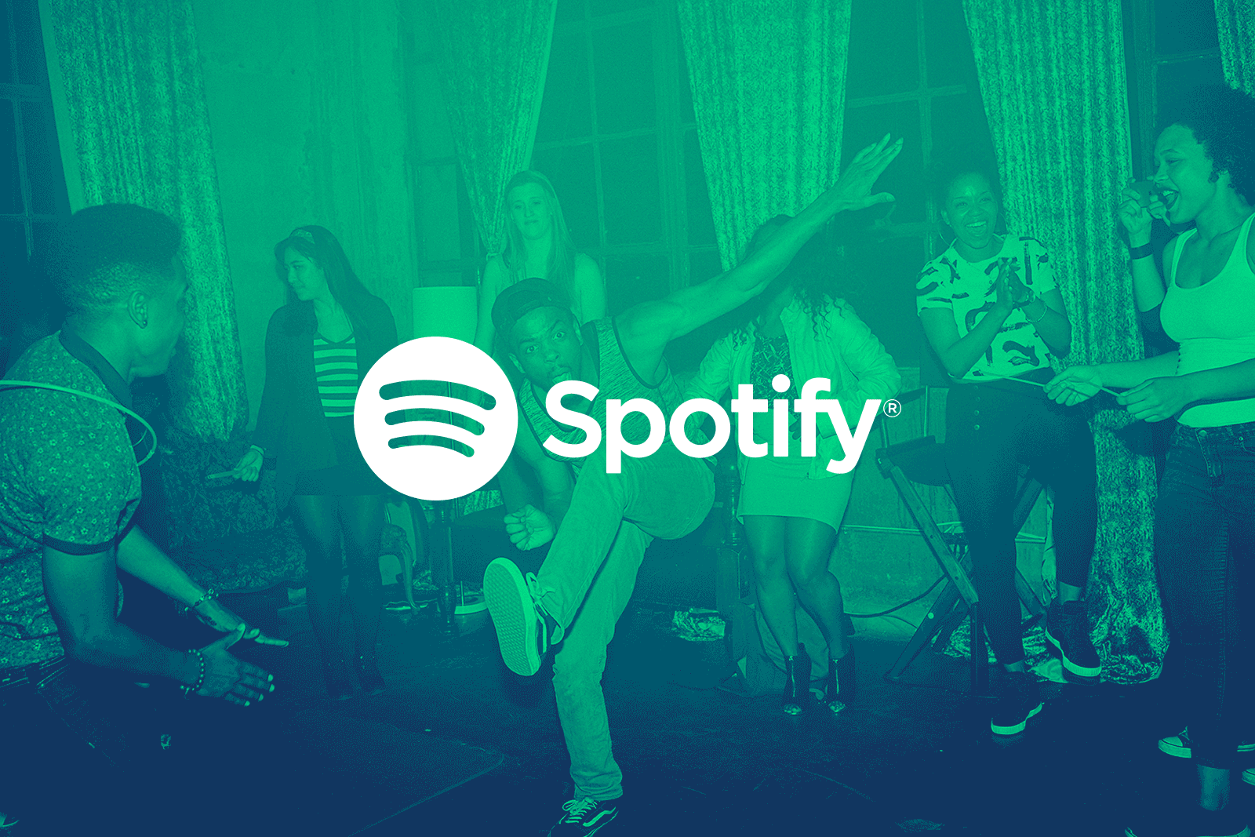
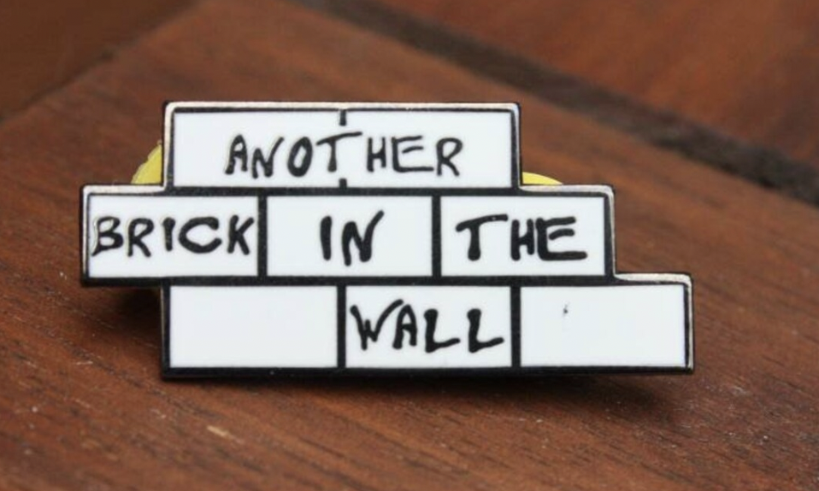
Another Brick in the Wall
Python Project: Spotify Music Analysis.
PROJECT GROUP - 06
SECTION - 0501

Slide 2
OBJECTIVE:
A new upcoming artist has approached us to assist him with creative music decisions which can help him gain a competitive advantage to produce successful music content with the help of our insights.

Slide 3
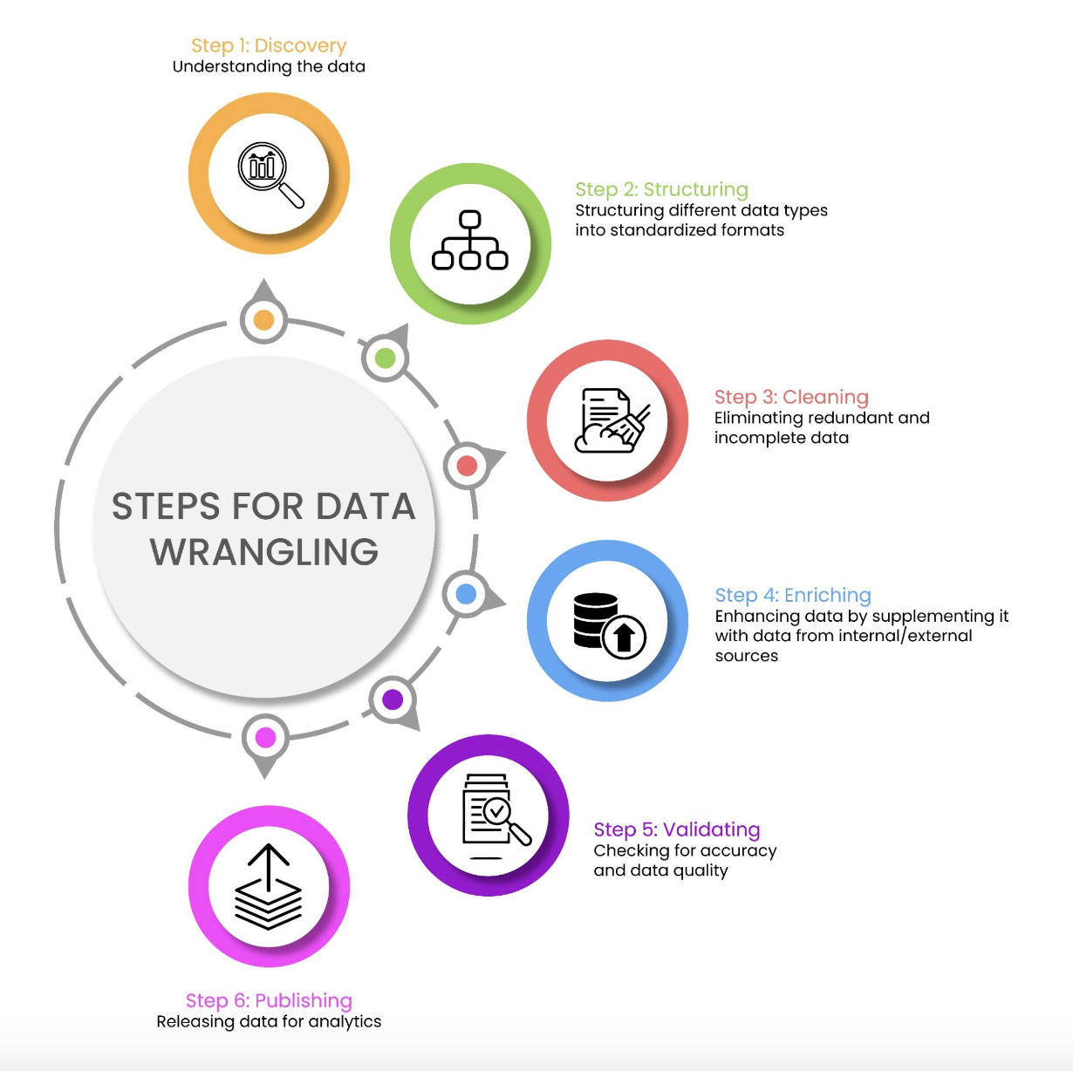
Data Wrangling:
We got our dataset comprising various artists, their songs, and the music metrics from 1942 to 2021 from a Kaggle dataset.
Since our dataset was limited till 2021, we got updated/real-time data from Spotify including playlists from 2022 using Spotipy API.
Data Cleaning: change the column formats, remove duplicates, concatenate both data frames, convert column data types
Resource: https://www.turing.com/kb/data-wrangling-and-importing-csv-in-python

Slide 4
Questions of Interest
01
03
02
02
04
Assess Popularity
Duration analysis
Does the artist with the highest number of followers have the most success?
Do people prefer listening to shorter songs over longer versions?
User Preferences
Collaborations work?
Which is the most influential metric when it comes to the success of a song?
How much does collaboration with different artists help in terms of success?

Slide 5
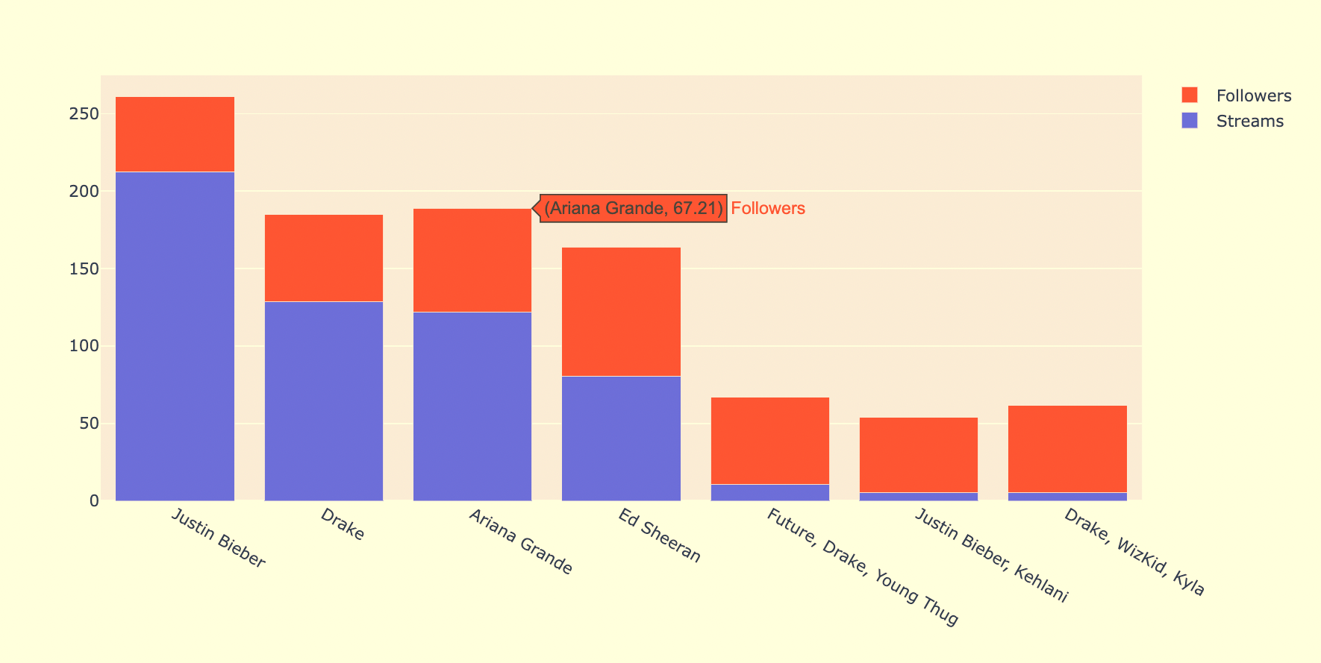
01
Question : Does the artist with the highest followers have the most success in today’s music industry?
Assumption : There is a positive correlation between the artist follower count and the number of streams.

Slide 6
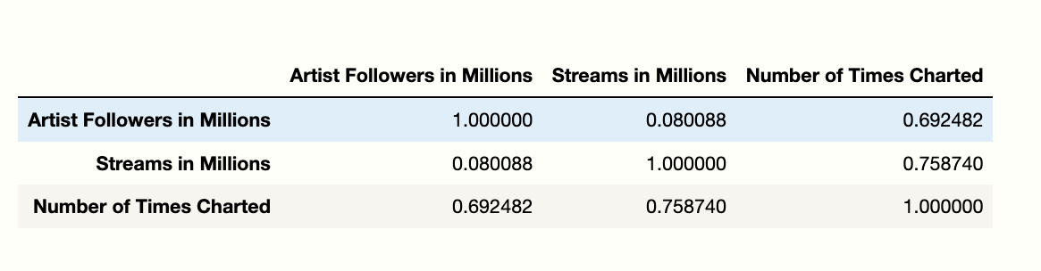

01
Recommendation:
Since we could not find a positive correlation between the artist follower count
and the number of streams, our assumption stands incorrect. Even a new artist
has a fair chance of producing a successful song.

Slide 7
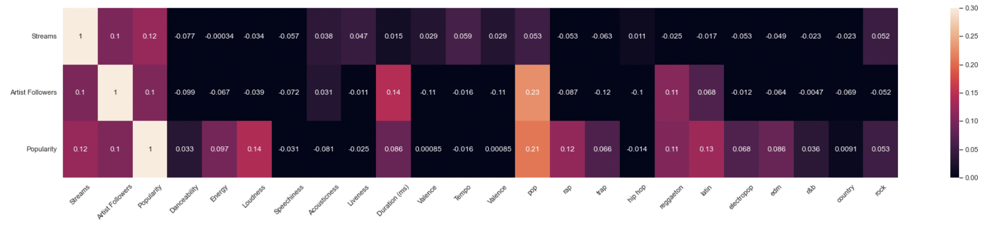
02
Question . Are there any influential metrics /factors when it comes to the success of a song?

Slide 8

Recommendation : no significant correlations of any song attribute with the song's success metrics such as Streams, Followers and Popularity.

Slide 9
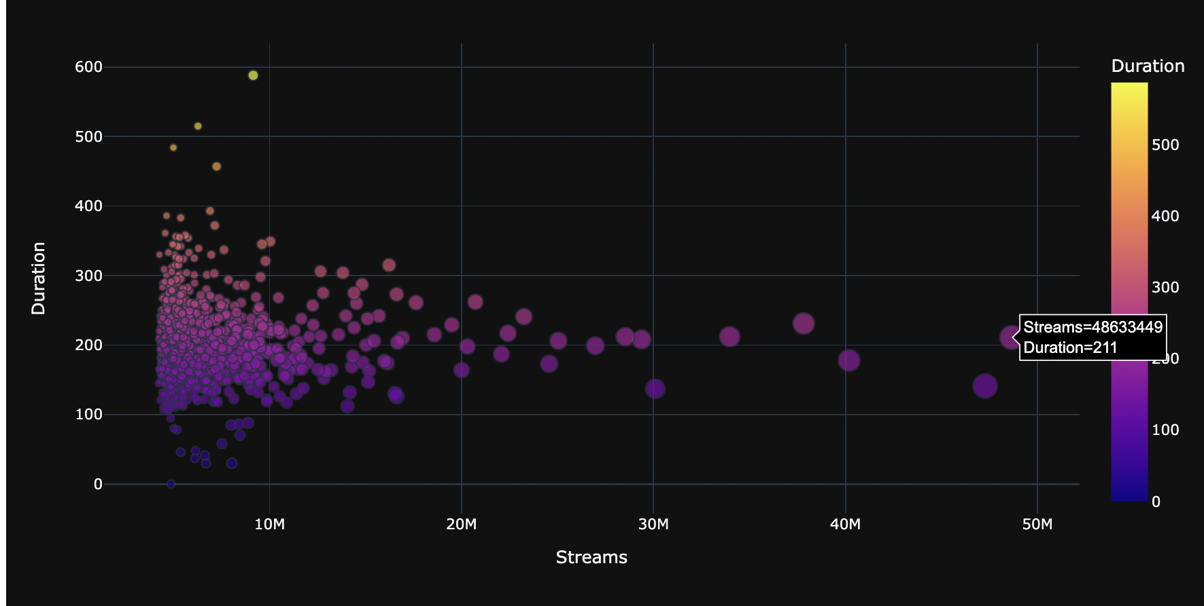
03
Question : Do people prefer listening to shorter songs over longer versions?
Assumption : Due to busier lives, people prefer shorter songs.

Slide 10
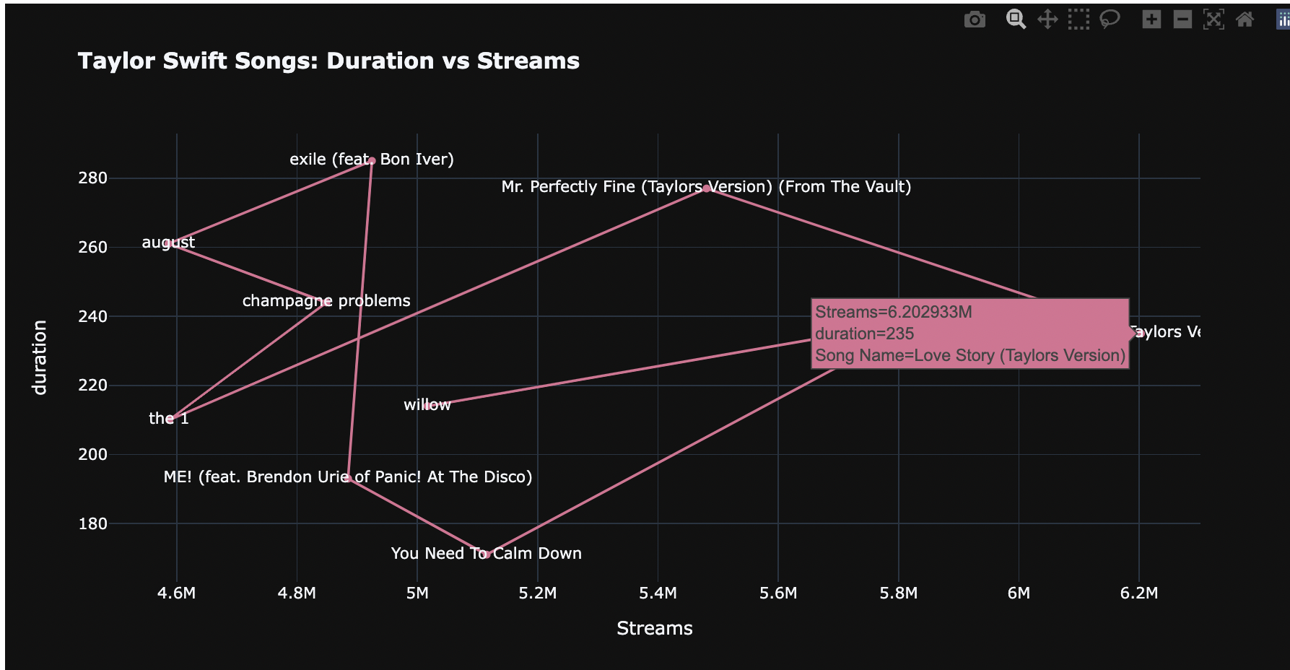
Recommendation:
03
To have a song duration of around 200 secs [btw 3 – 3.30 min] to ensure the success
of the song.

Slide 11
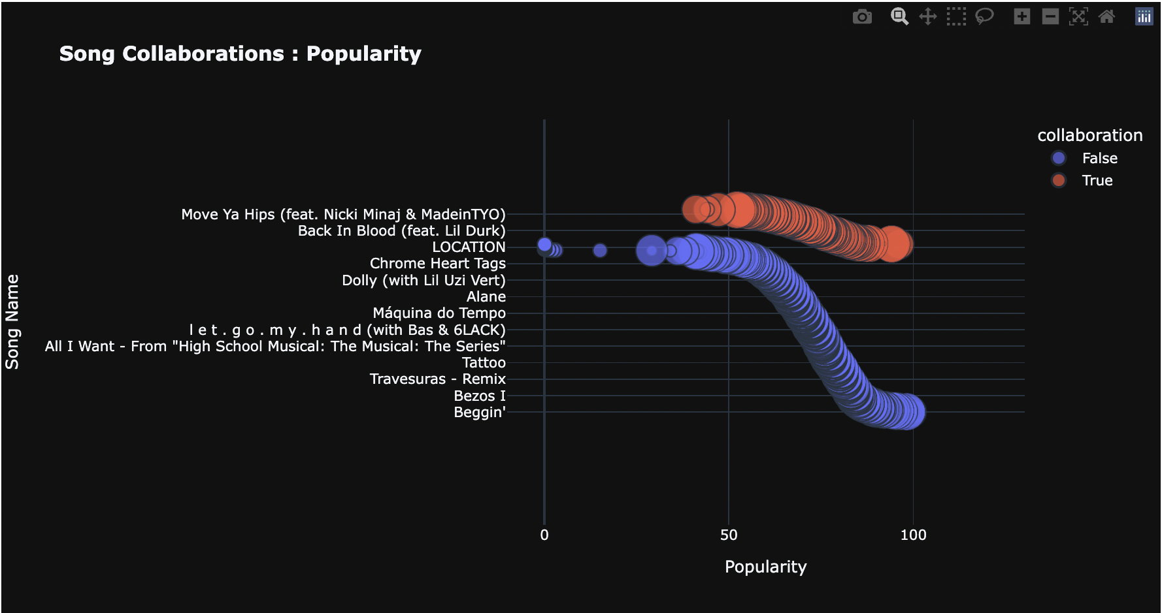
04
Question : How much does collaboration with different artists help in terms of success ?
Assumption : Song Collaborations work better than singles.

Slide 12

Recommendation:
With the help of our insights, we strongly advise our client to move forward with collaborations in order to attain sky-high numbers and success in the music business.

Slide 13
Conclusion
The insights are extremely meaningful as we believe that if our client focusses on collaboration with new artists while creating shorter duration tracks and exploring their musical creativity, they should be able to churn out bangers month after month!

Slide 14
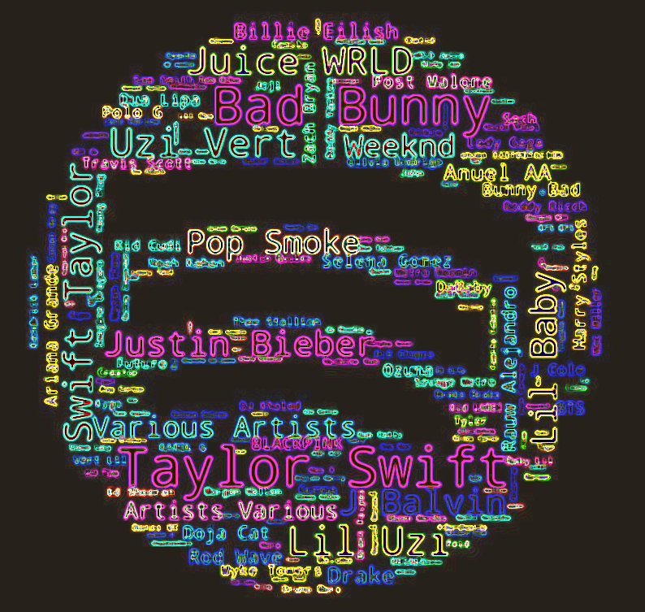
THANK YOU AND PLEASE, DON´T STOP THE MUSIC!!

